Slide 1
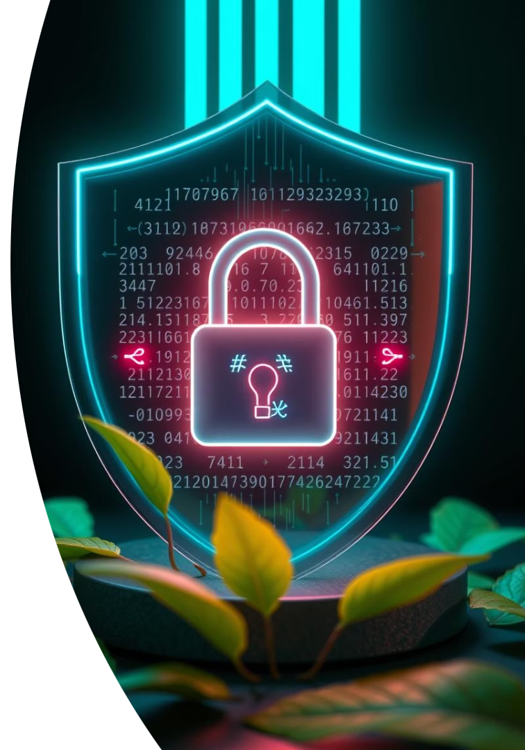

Password Generators: Fortifying Your Digital Defenses
Discover how password generators protect your online accounts and secrets. Embrace stronger security with complex, random passwords.
by Likhitha Polagani

Slide 2
The Password Problem: Why "Password123" Doesn't Cut It
Common Password Pitfalls
Consequences
Easy to guess
Account takeover
Reused across sites
Identity theft
Vulnerable to hacking
Loss of sensitive data

Slide 3
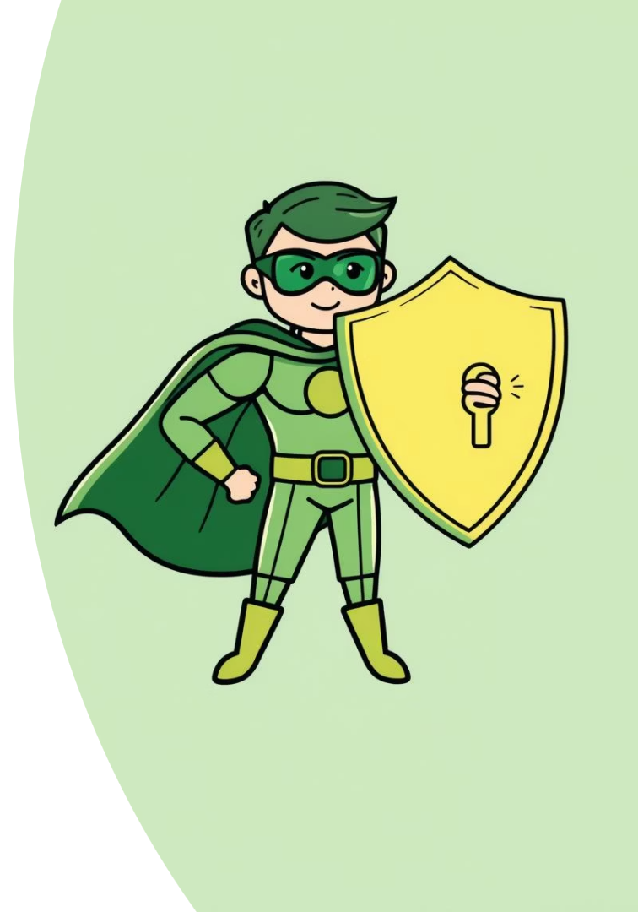
What is a Password Generator? A Security Superhero
Creates Random Passwords
Enhances Security
Reduces risk of password guessing and attacks.
Generates complex and unpredictable strings.
Easy to Use
Customizable options for every user type.

Slide 4
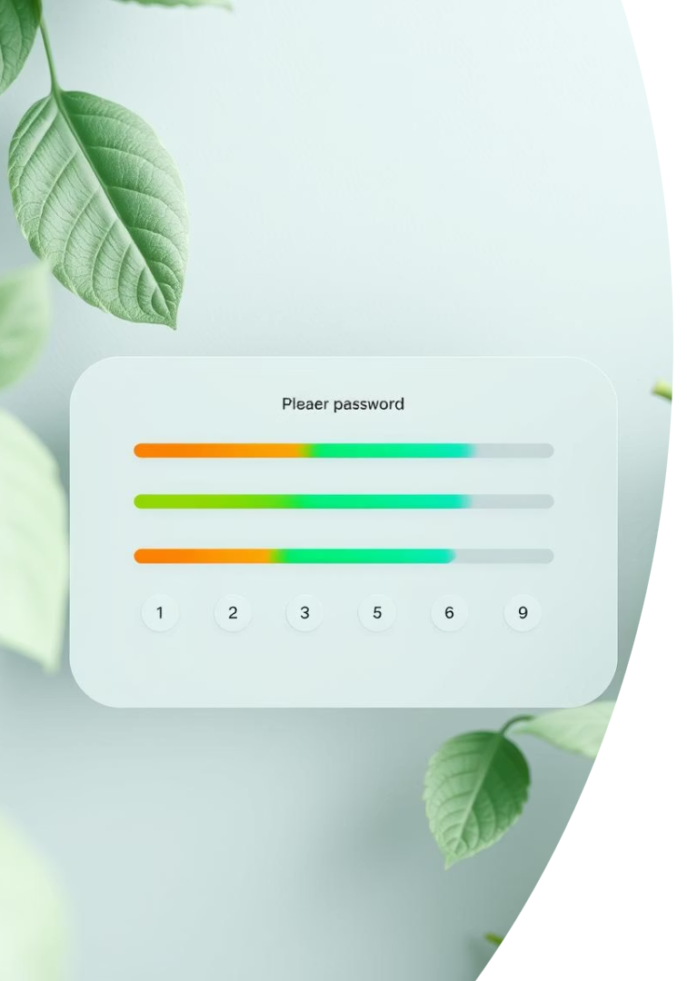



Customization Options: Tailoring Passwords to Your Needs
Specify Length
Character Types
Exclude Similar Characters
From short to ultra-long passwords.
Choose uppercase, lowercase, numbers, symbols.
Avoid confusing characters for clarity.

Slide 5

The Science of Randomness: How Generators Create Unbreakable Codes
Password generators use entropy sources and algorithms to ensure unpredictability. True randomness makes cracking nearly impossible.
Entropy Sources
Mouse movement, system clock
Algorithms
Cryptographic functions
Output
Random strong passwords

Slide 6

Beyond Brute Force: Why Strong Passwords Matter
1
Resist Automated Attacks
2
Protect Personal Data
Strong passwords block common cracking methods.
Minimize risk of identity theft and fraud.
3
Maintain Privacy
Keep sensitive info secure from intruders.

Slide 7
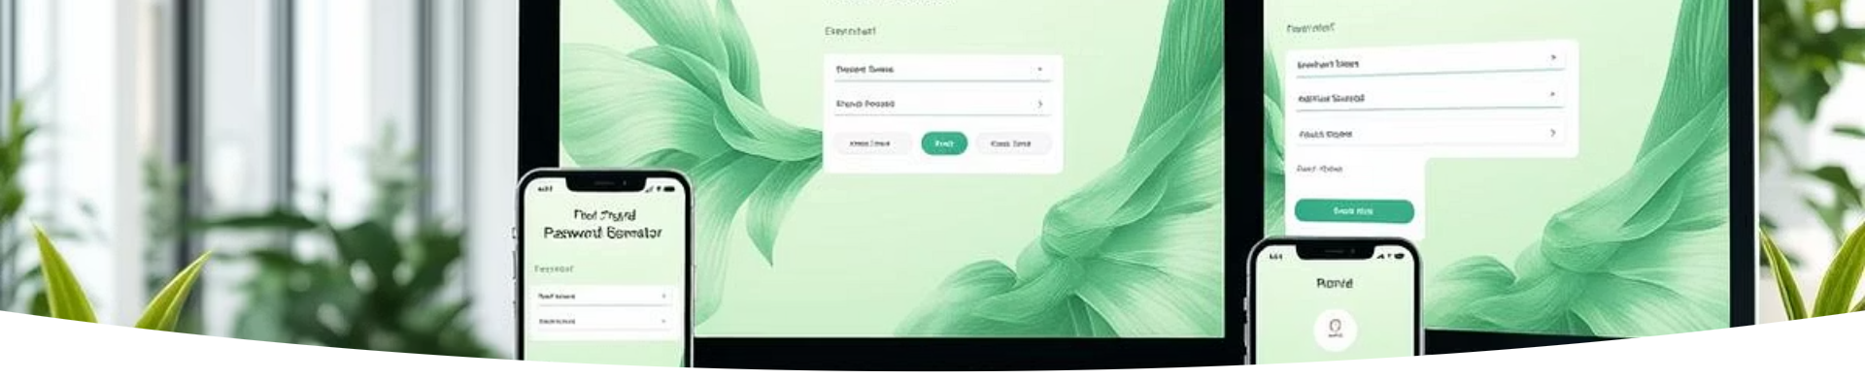
Choosing the Right Generator: Features and Considerations
Security
Usability
Extra Tools
Open source or vetted code
Easy customization
Password strength meters
Local vs. cloud generation
Cross-platform support
Storage options

Slide 8
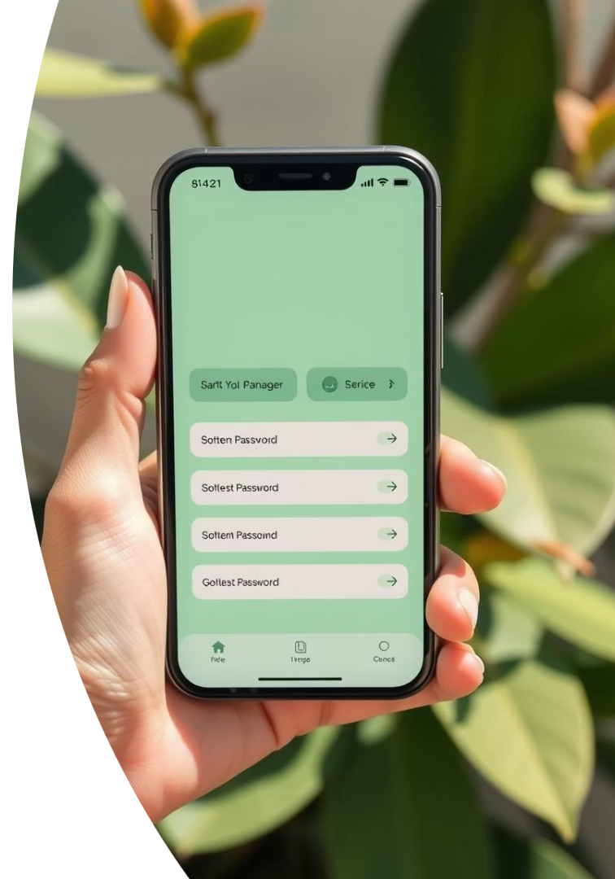

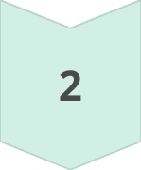
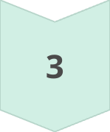
Best Practices: Using Password Generators Effectively
Generate Unique Passwords
Use different passwords for different accounts.
Use a Password Manager
Securely store complex passwords to avoid forgetting.
Update Regularly
Change passwords periodically for ongoing security.

Slide 9
Real-World Examples: How Strong Passwords Prevent Cyberattacks
Case Study 1
Case Study 2
Case Study 3
Strong passwords blocked ransomware attack attempts.
Randomized credentials stopped phishing intrusion risks.
Password complexity deterred brute force hacking.

Slide 10

Take Control of Your Security: Generate Strong Passwords Today!
Choose a Trusted Generator
Customize Password Criteria
Securely Store and Use
Stay Vigilant and Update
Start strengthening your online defenses with easy, secure passwords.

